Slide 1
REVEALING AND CLASSIFICATION OF DEEP FAKE IMAGES WITH VIDEOS USING CUSTOMIZED DEEP LEARNING MODELS
PRESENTED BY:
PRAVEEN KUMAR K
(717822Z135)
Subject Code-21ZD04
SUPERVISOR:
Mr. RAMPRASHATH R ASST.PROF., MCA, M.PHIL., MBA., NET.
SCHOOL OF COMPUTER APPLICATIONS

Slide 2
COMPANY PROFILE
NoviTech is an innovative technology company dedicated to product engineering, with particular emphasis on industries such as automotive and robotics, industrial electronics, high tech, projects, and training programs. Our engineers and developers have decades of experience crafting intelligent systems and devices for complex problems. We are passionate about developing customized solutions that maximize efficiency and deliver measurable value to businesses.
Whether you need help improving production processes, implementing automation, developing cutting-edge products, or training personnel on new technologies, NoviTech can provide comprehensive and tailored support.

Slide 3
TABLE OF CONTENTS
SL.NO | TITLE | PAGE NUMBER
01 | ABSTRACT | 4
02 | INTRODUCTION | 5
03 | LITERATURE SURVEY | 7
04 | SYSTEM ANALYSIS | 9
05 | SYSTEM DESIGN | 11
06 | TOOLS AND TECHNOLOGIES | 15
07 | PROJECT DESCRIPTION | 16
08 | CONCLUSION AND FUTURE ENHANCEMENT | 25
09 | SCREENSHOTS | 26
10 | REFERENCES | 33

Slide 4
1. ABSTRACT:
Deep fakes are becoming more common; they include editing previously published films and photos to produce content that appears authentic but is wholly fake. The development process has been considerably expedited by the widespread availability of deep learning techniques, such as autoencoders, Generative Adversarial Networks (GANs), and user-friendly software. These sophisticated algorithms adeptly fuse and modify visual and audio elements, facilitating the production of content that closely mimics genuine footage, even for those without specialized knowledge.
The malicious manipulation of images and videos poses significant security and societal concerns. With an emphasis on facial alteration, the goal of this research is to create a deep learning perfect for the detection and classification of deepfake images and videos. The dataset used for the project is either Face Forensics++, Celeb-DF, or the Deepfake Detection Challenge Dataset (DFDC), available on Kaggle, consisting of real and deepfake images and videos. By utilising Recurrent and Convolutional Neural Networks, we have made development in DF detection. Commencing with preprocessing the data, extracting frames from the videos, and separating the dataset into training and validation sets. For the detection and classification of deepfake images and videos, OpenCV, and Face Recognition for facial detection, Convolutional neural networks (CNNs) are used by the system to extract features at the frame level. A Recurrent neural network is trained using these features (RNN).

Slide 5
2. INTRODUCTION:
Smartphones with good cameras and fast internet have made it easy to create and share videos online. At the same time, new computer technology has allowed for the creation of deepfakes—videos that are altered using advanced techniques like Generative Adversarial Networks (GANs) and autoencoders.
These deepfakes can spread false information on social media and cause serious problems for society. To address this issue, our project aims to develop a strong computer program that can find and sort deepfake videos and pictures, focusing on changes to people's faces. We'll use different sets of data that include both real and fake media to train our program. Our method looks closely at how deepfakes are made, particularly focusing on the way GANs work.
By analyzing small differences between real and fake images, our program can spot deepfakes. We'll also use techniques like adjusting learning rates and stopping early to improve our program's accuracy. Our goal is to stop the spread of deepfake media and protect the truth online.

Slide 6
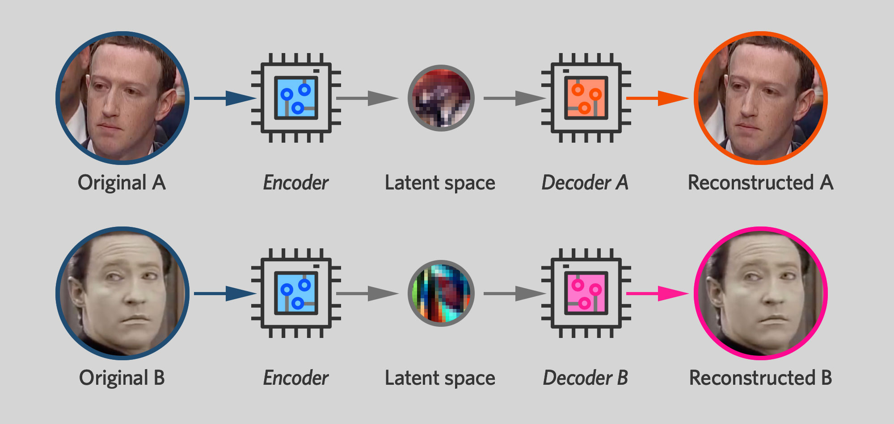
How Deep Fakes Are Created ?
Tools for deep fake creation.
Faceswap
Faceit
DeepFaceLab
DeepfakeCapsuleGAN
Large resolution facemasked

Slide 7
3. LITERATURE SURVEY
Title | Deepfake Video Detection Using Convolutional Neural Network
Objective | This paper proposes a deep learning model utilizing convolutional neural networks (CNNs) to detect deepfake videos by analyzing facial feature inconsistencies and compression rates, aiming to combat the increasing threat of sophisticated AI-generated fake content.
Solution methodology | To detect deepfake videos, the paper suggests using a convolutional neural network (CNN) with transfer learning. This CNN analyzes video frames to spot inconsistencies introduced during deepfake creation. By training on the Celeb-DF dataset, the model learns to recognize these discrepancies. The paper also explores methods to enhance the model's learning process.
Results | The CNN-based model, trained on the Celeb-DF dataset, demonstrates promising performance in identifying deepfake videos by discerning subtle discrepancies in facial features and compression rates, showcasing a potential solution to the challenge of deepfake detection.
Observation | The research highlights the effectiveness of leveraging deep learning techniques, particularly CNNs, in detecting deepfake content, emphasizing the importance of continued advancements in AI-based detection methods to mitigate the societal risks posed by the proliferation of fake videos.

Slide 8
3. LITERATURE SURVEY
Title | Revealing and Classification of Deepfakes Video’s Images using a Customize Convolution Neural Network Model
Objective | This study aims to detect fake images from real ones in deepfake videos, using advanced learning methods to improve accuracy and address the dangers of manipulated media.
Solution methodology | Using a tailored CNN model, the research analyzes video frames, facial features, and data to identify deepfake images. Additional layers like dense layers, MaxPooling, and dropout layers enhance the model's effectiveness.
Results | The customized CNN algorithm successfully identifies deepfake images, outperforming other methods with 91.4% accuracy, low loss (0.342), and an AUC of 0.92. Testing also shows high accuracy (85.2% for CNN and 95.5% for MLP-CNN), confirming the method's effectiveness.
Observation | The customized CNN model outperforms other methods, achieving 91.4% accuracy, reduced loss, and an AUC of 0.92. These results underscore the effectiveness of deep learning approaches in combating the proliferation of deepfake content and highlight the importance of continuous advancements in detection technologies.

Slide 9
4. SYSTEM ANALYSIS
4.1 EXISTING SYSTEM:
Deepfake videos are causing big problems for important values like democracy and fairness. People are working hard to find ways to stop them. One method uses a special computer program called a Convolutional Neural Network (CNN) to spot fake parts of faces in videos. Another idea focuses on looking for eye blinking, which is hard to fake in videos made by computers. Some researchers are using capsule networks to find fake images and videos in different situations. They're trying to improve their methods to work well in real-life situations without mistakes. There are also methods that use biological signals to detect fake videos, but they have some challenges to overcome.
Disadvantages of Existing system:
High computational requirements, demanding powerful hardware for training.
Vulnerable to adversarial attacks, compromising model robustness and reliability.
Limited interpretability, making it challenging to understand model decisions.

Slide 10
4. SYSTEM ANALYSIS
4.2 PROPOSED SYSTEM:
Many tools make deepfake (DF) content, but reliable detection tools are rare. This new approach aims to detect DF in both images and videos, which is a big step in stopping fake image and videos. It plans to make a simple website where people can upload images and videos to check if they're fake or real. If successful, it could become a browser add-on for finding deepfakes automatically. We want to see if people like using it and if it works well in terms of security, accuracy, reliability, and ease of use. The focus is on three types of deepfakes: replacement, retrenchment, and interpersonal.
Advantages of Proposed system:
New techniques effectively detect deepfakes in both images and videos.
Provides comprehensive coverage against various forms of digital manipulation.
Strengthens defense against evolving deepfake methods in multimedia content.
Offers versatility in identifying deceptive media across different online platforms.

Slide 11
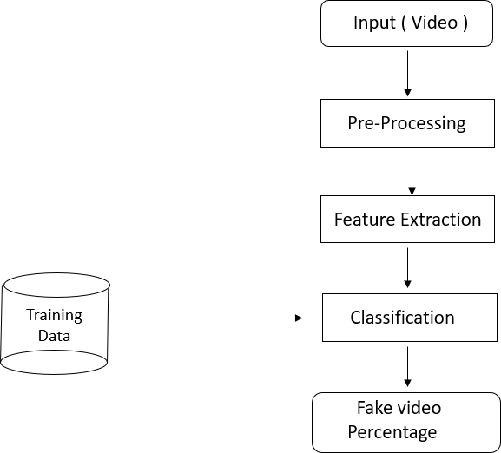
5. SYSTEM DESIGN
5.1 DFD Level-1

Slide 12
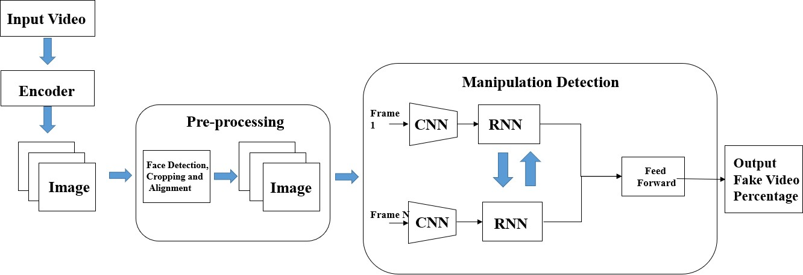
5. SYSTEM DESIGN
5.2 DFD Level-2

Slide 13
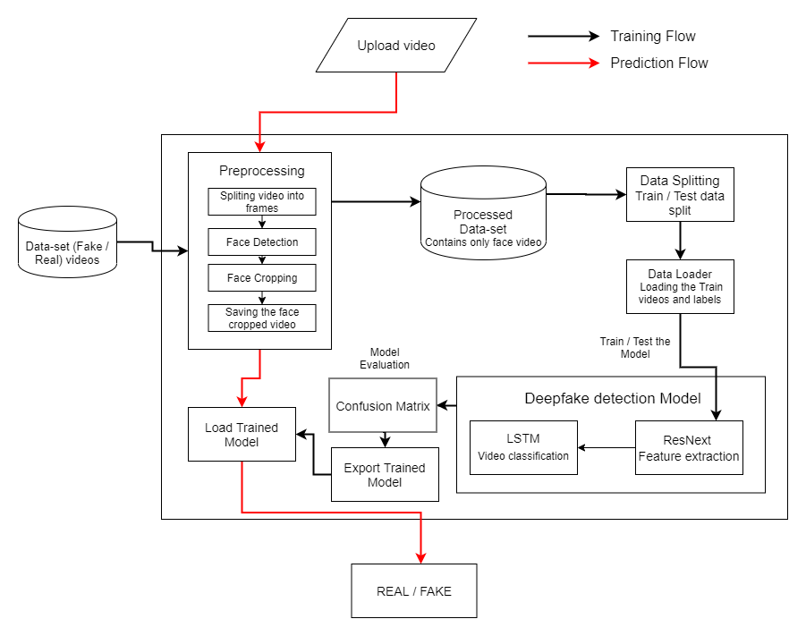
5. SYSTEM DESIGN
5.3 SYSTEM ARCHITECTURE:

Slide 14
6. TOOLS AND TECHNOLOGIES:
6.1 HARDWARE REQUIREMENTS:
Operating System: Compatible with Windows and Linux.
RAM: 16GB (recommended) or 8GB (minimum requirement)
Hard Disk: 100GB working space (recommended) or 50GB (minimum requirement)
GPU: NVIDIA CUDA-enabled GPU (recommended for improved deep learning performance)
6.2 SOFTWARE REQUIREMENTS:
Languages: Python 3.6 or higher
IDE: Python 3.6.0 , vscode
Framework: Django
Technology: Advanced programming using Python with GPU support for deep learning (NVIDIA CUDA)

Slide 15
7. PROJECT DESCRIPTION
This project deals with the problem of fake videos and pictures made using advanced technology. It focuses on finding and sorting out these fake images and videos, especially ones that change people's faces. By using special computer programs and datasets of real and fake media, the project learns to recognize fake content. It looks at individual frames of videos and uses different techniques to understand if they're real or fake. The goal is to stop the spread of fake media and make sure people can trust what they see online.
Data-set exploration
Pre-processing
Training workflow
Prediction workflow
Model architecture
Results

Slide 16
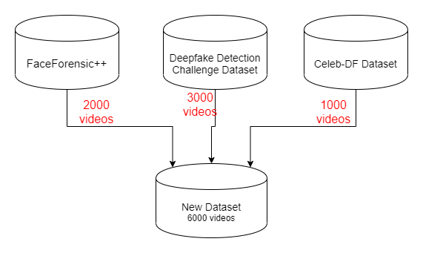

7.1 DATA-SET EXPLORATION
The dataset used for the project is either Face Forensics++, Celeb-DF, or the Deepfake Detection Challenge Dataset (DFDC), available on Kaggle (https://www.kaggle.com/), consisting of real and deepfake images and videos.

Slide 17
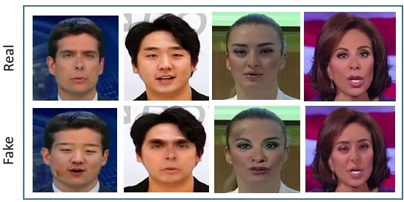
Samples from the FaceForensics++ dataset depicting both unaltered and manipulated facial images.

Slide 18
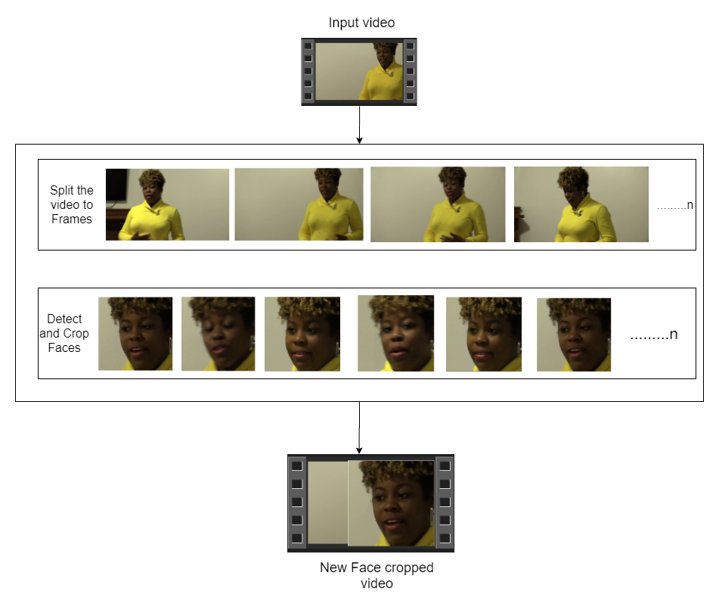
7.2 PRE-PROCESSING:
Video detection, on the other hand, follows a different approach. We first preprocess the videos using ResNext CNN, which LSTM network is used to carry out the real detection. This combination allows for a comprehensive analysis of temporal patterns within the videos, aiding in the accurate identification of deepfake content.
SPLIT VIDEO INTO FRAMES
FACE DETECTION
CROPING FACE
CREATING NEW FACE CROPPED VIDEO
SAVING THE FACE CROPPED VIDEO

Slide 19
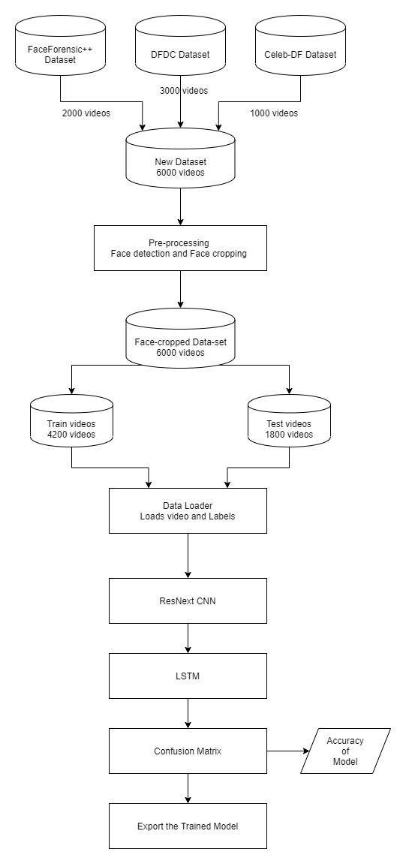
7.3 TRAINING WORKFLOW:
To detect deepfake videos, we use a two-step process. First, we prepare the videos using a special type of computer program called ResNext CNN. This program helps us get the videos ready for analysis. Then, we use another program called LSTM network to actually detect whether the videos are real or fake. This method helps us look closely at how things change over time in the videos, which is important for spotting deepfakes. By combining these two programs, we can better understand the patterns in the videos and accurately identify any fake content.

Slide 20
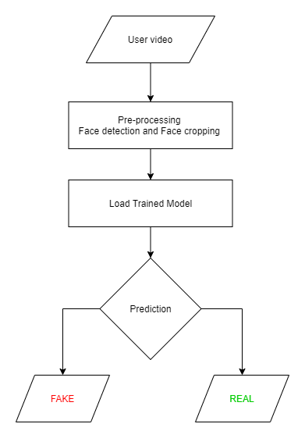
7.4 PREDICTION WORKFLOW:
A fresh video is given to the trained algorithm for forecasting. In addition, the format of the learnt model is imported by preprocessing a new video. The faces in the divided video are cropped once it has been divided into frames, and instead of being kept locally, the cropped frames are transmitted directly to the trained model for detection. Figure 5 shows the prediction procedure.

Slide 21
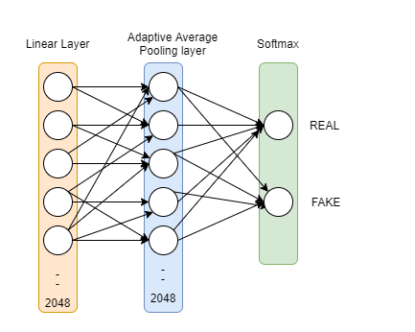
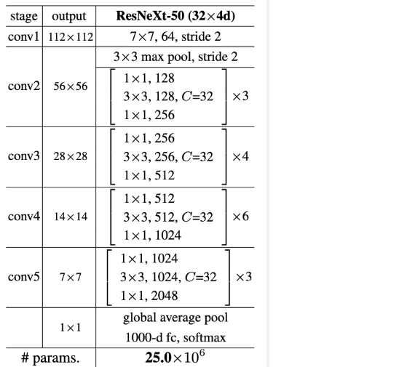

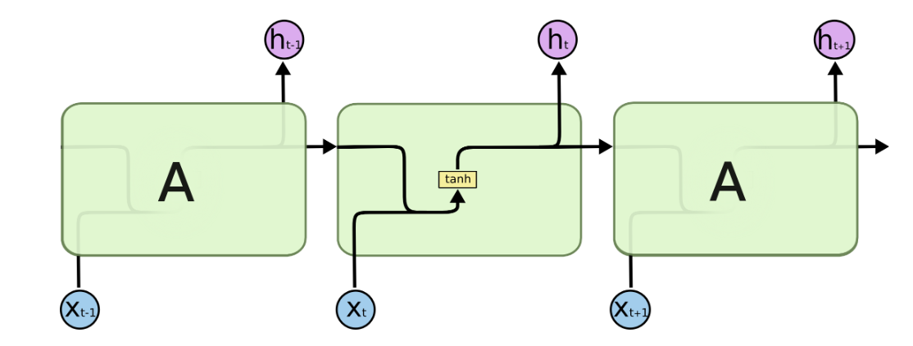
7.5 MODEL ARCHITECTURE
ResNext-50
Sequential Layer
1 LSTM layer with 2048 shape input vector and 2048 latent features along with 0.4
chance of dropout and ReLU Activation function

Slide 22
8. CONCLUSION AND FUTURE ENHANCEMENT
Our project introduces a neural network approach to differentiate between real and fake images and videos, along with the confidence of the proposed model. We were inspired by how deepfakes are made using GANs with the assistance of Autoencoders. Our method analyzes each frame of the content using ResNext CNN for images and RNN with LSTM for videos. By considering specific parameters, our model accurately identifies whether the content is authentic or manipulated. We expect our method to perform well when applied to real-world data in real-time scenarios.
FUTURE ENHANCEMENT
As for our project, we haven't focused on audio detection yet. This means our method can't identify audio deepfakes. However, we aim to overcome this limitation in future research. Our goal is to develop techniques that can uncover even the most sophisticated audio deepfakes, ensuring comprehensive detection capabilities.

Slide 23
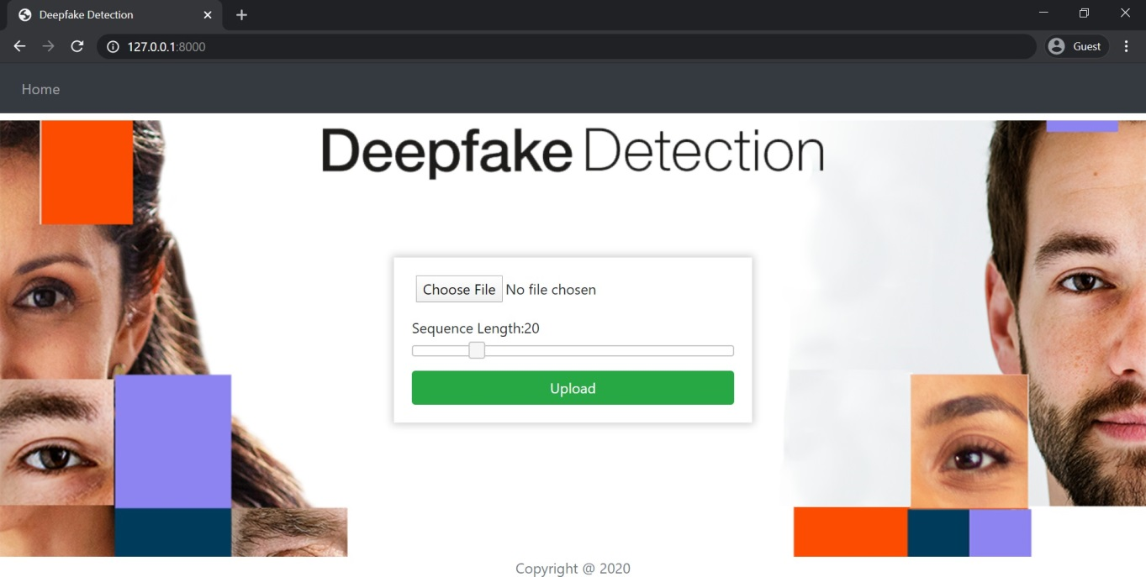
9. SCREENSHOTS

Slide 24
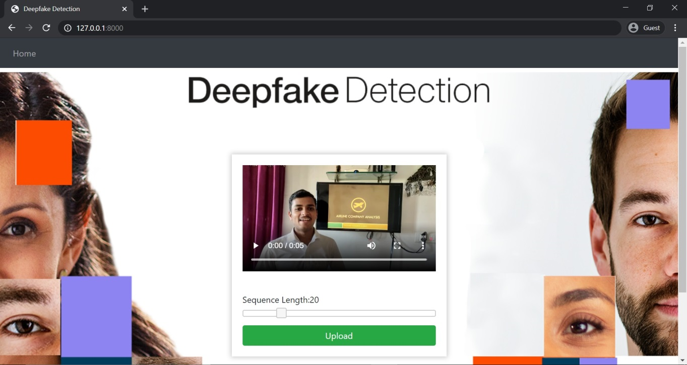
9. SCREENSHOTS

Slide 25
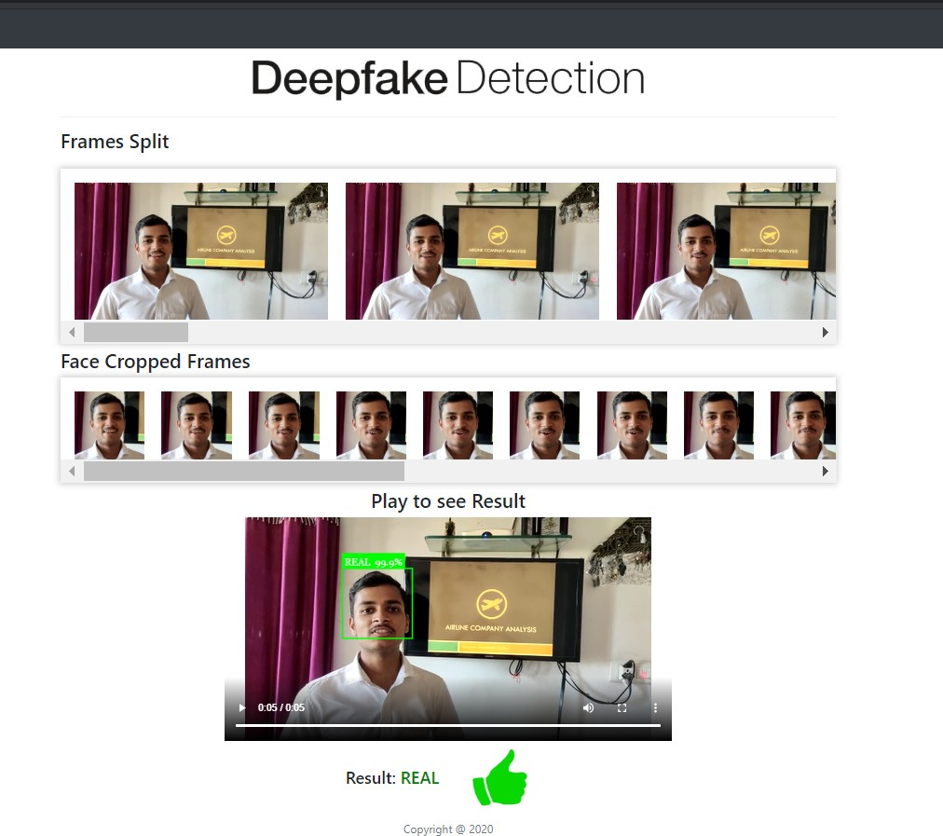
9. SCREENSHOTS

Slide 26
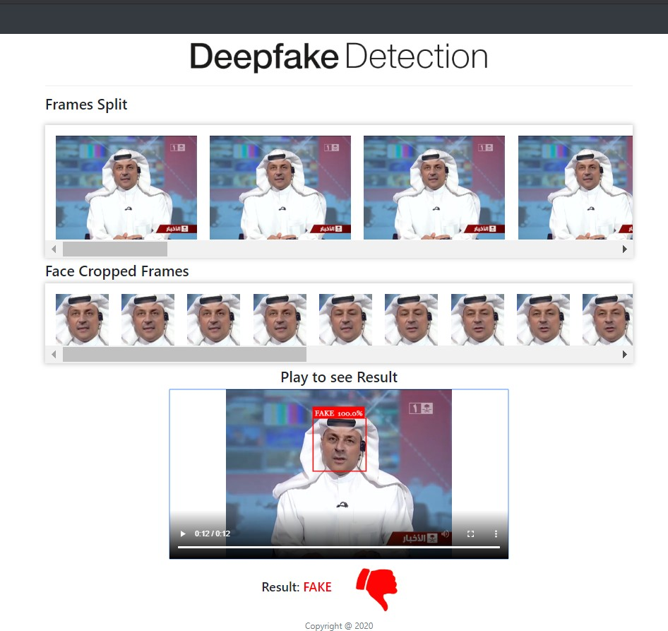
9. SCREENSHOTS

Slide 27
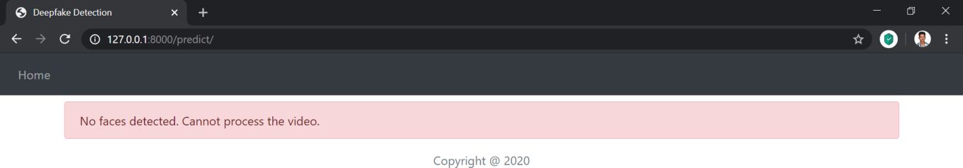
9. SCREENSHOTS

Slide 28
PUBLICATION DETAILS
Conference / Journal : 12th International Conference on Contemporary Engineering and Technology 2024.
Title : REVEALING AND CLASSIFICATION OF DEEP FAKE IMAGES WITH VIDEOS USING CUSTOMIZED DEEP LEARNING MODELS
Authors Details : Praveen Kumar K.
Paper id : ICCET241406
Status : ISBN 978-81-965908-5-7
Paper Presentation Completed ,Certification Received.
Publication in book chapter and sent final proof proceed
Acceptance from Publisher and Waiting for Publication.

Slide 29

PUBLICATION DETAILS

Slide 30
REFERENCES
Yuezun Li, Ming-Ching Chang and Siwei Lyu “Exposing AI Created Fake Videos by Detecting Eye Blinking” in arxiv.
Huy H. Nguyen , Junichi Yamagishi, and Isao Echizen “ Using capsule networks to detect forged images and videos ”.
Hyeongwoo Kim, Pablo Garrido, Ayush Tewari and Weipeng Xu “Deep Video Portraits” in arXiv:1901.02212v2.
Umur Aybars Ciftci, ˙Ilke Demir, Lijun Yin “Detection of Synthetic Portrait Videos using Biological Signals” in arXiv:1901.02212v2.
A. M. Almars, “Deepfakes Detection Techniques Using Deep Learning: A Survey,” J. Comput. Commun., 2021, doi: 10.4236/jcc.2021.95003.

Slide 31


